Slide 1
SASK LONG COVID PARTICIPANT PORTAL
Stakeholder - Dr. Osgood
CMPT 371 - Team 2 ID 3

Slide 2
Responsibilities
Project Manager | Build Manager | Risk Manager | Dev Lead | Devs | Test Lead | Testers
Jeet | Riley | Hari | Ini | Herve, Alex | Sashti | Vaidehi, Chi

Slide 3

Task Delegation
Asana
The PM created tasks for the Dev and the Test team at the beginning of this deliverable.
Tasks include user stories, mini milestones and general to dos.
Tasks on Asana had
An estimation time
Priority of the task
Status of completion
Assigned people on that task
We focused on getting the functionality down for our system.
Dev team worked on frontend-backend-database communication.
While the test team improved the test plan and test matrix.

Slide 4

Requirements Set for this deliverable
Our main goal for this deliverable was to
Have the user register/login to the webapp
Admins can approve users’ registration request
Implementing more features on the dashboard page
Display user data in tables and graphs
Render the ‘My Journey’ view with filter options
Implement Unit and Integration testing
Improving the risk plan and its management

Slide 5
Changes or adoption in technologies
Stopped using the frontend template as it presented too many problems
Started frontend from scratch using same technologies( essentially moved to ID 1’s frontend )
Adaption of Asana for task delegation began this deliverable

Slide 6
Current State of the system
Removal of frontend template to get rid of the issues encountered
Login/ Registration system implemented(also connected with the backend)
Communication and connection set between frontend, backend and database
User profile and features of the dashboard currently under construction
Some sort of unit testing has begun; No integration testing yet
Only manual testing(UI testing) conducted so far
Notes:
After signing in from the home page, the user will be directed to the dashboard.
When the Register Now button is clicked, it leads to the registration page, which is currently a dead end as we do not yet have clarification on if we would be handling registration from our end and have someone authenticate it, or if someone (outside our system) does the registration for every participant and gives them their registration details.

Slide 7
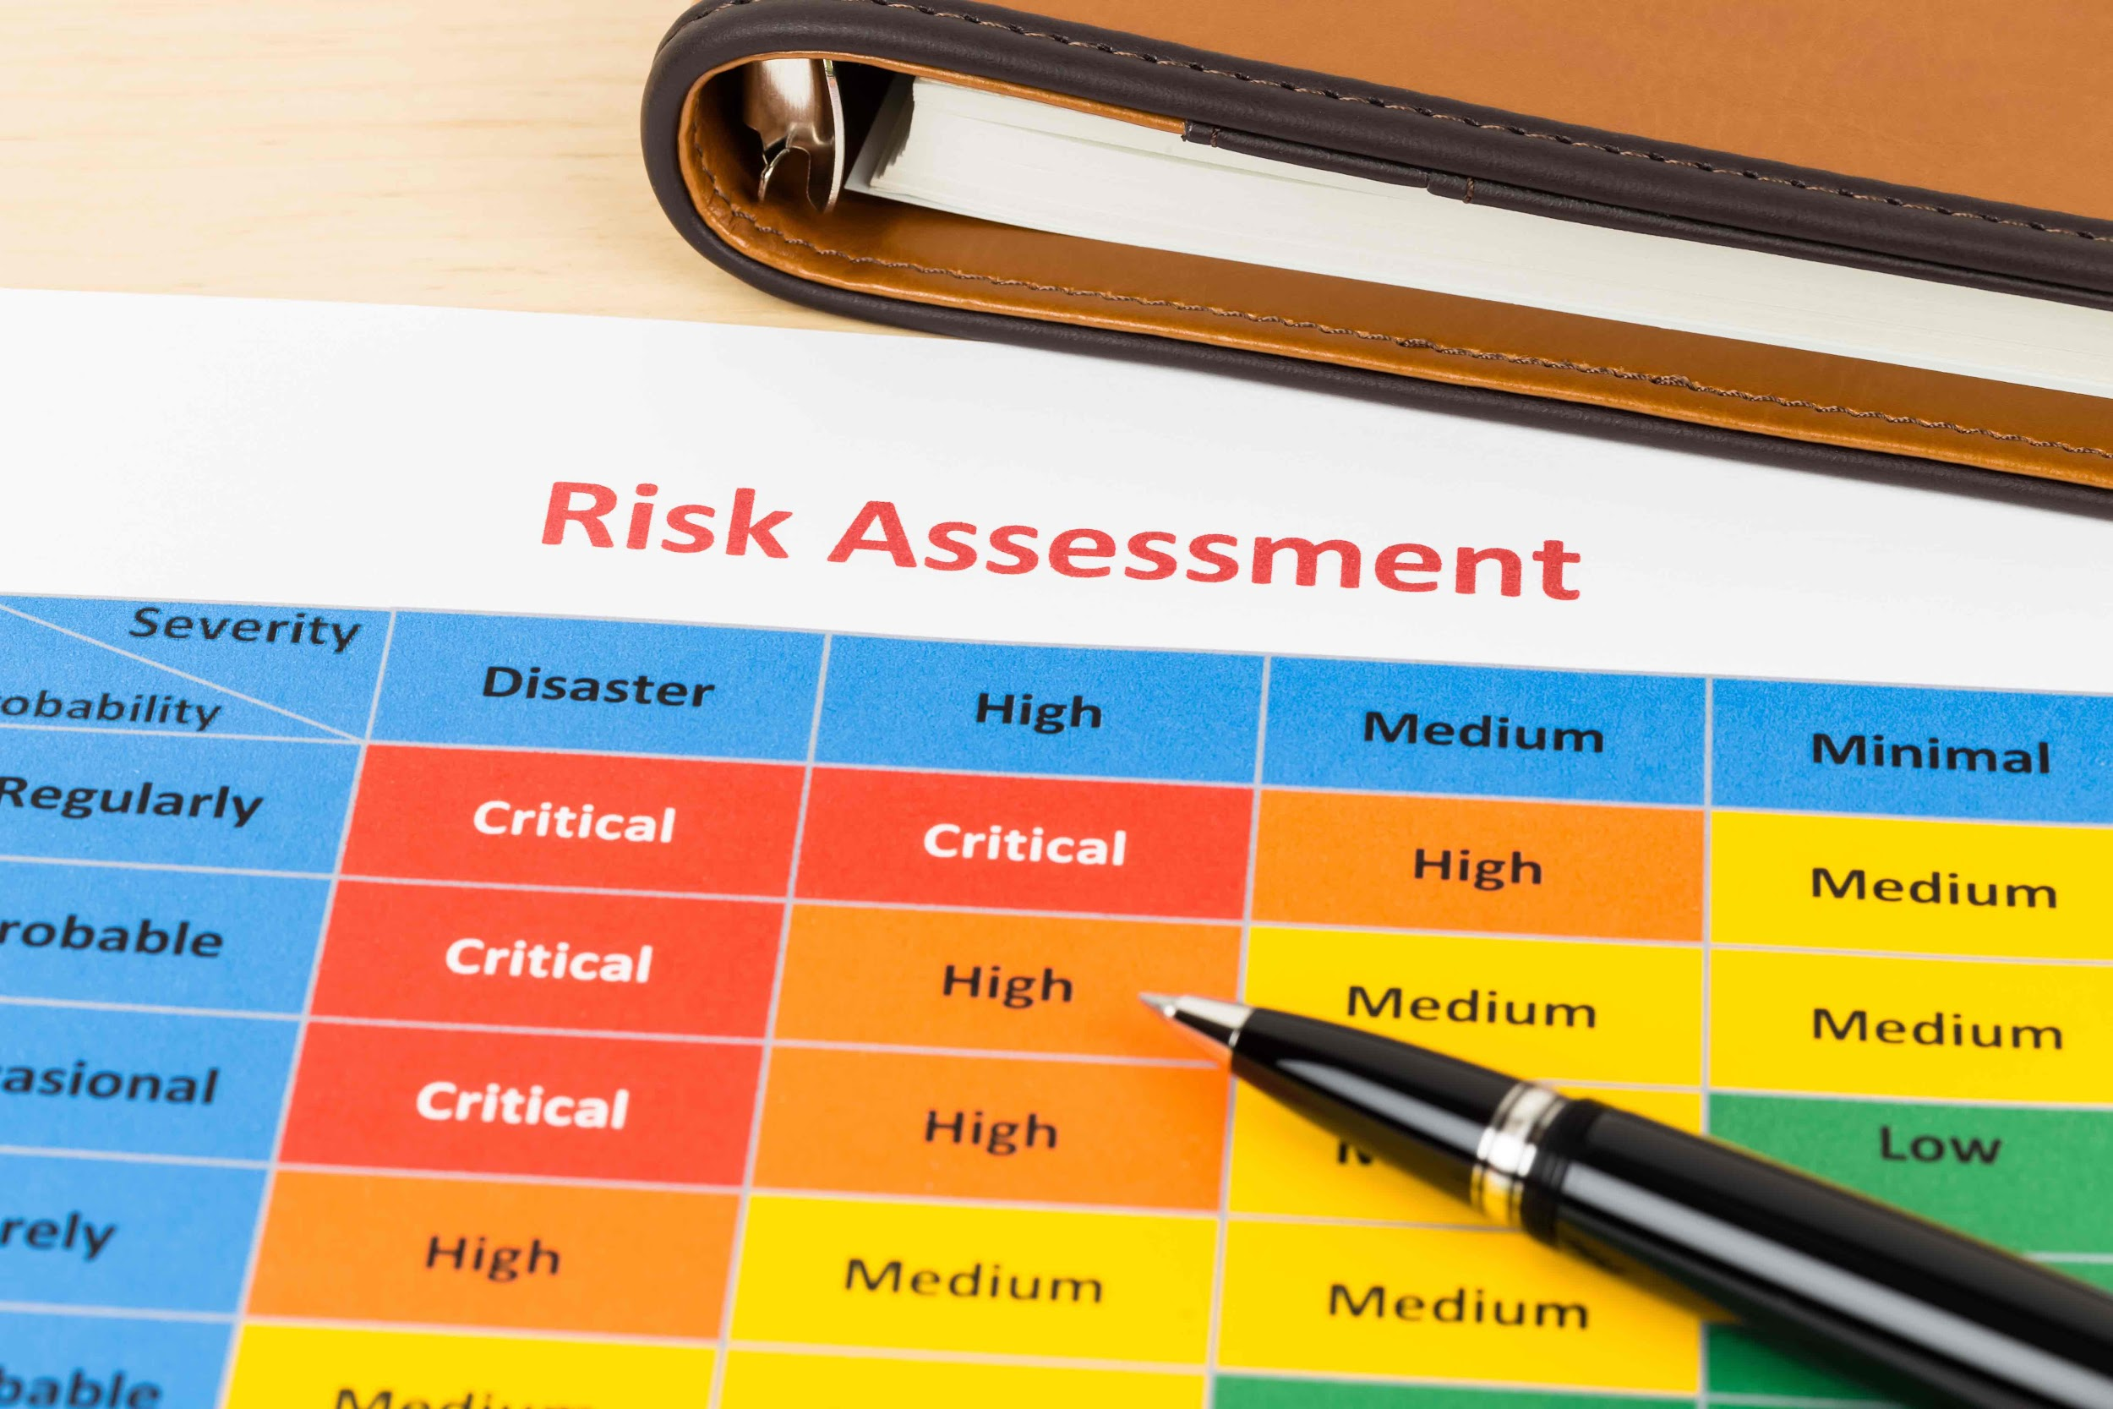
Risk List and Risk Report
A risk format is created to identify and explain the risk and its probability, probability and severity.
If the priority is 0, that indicates the risk has been solved and we are keeping it as a record in case it comes back.
We have categorized risks in the following:
Code Risks
Management Risks
Operational Risks
Security Risks
We also plan to create a detailed risk matrix in the coming deliverables.
Notes:
This deliverable we focused on creating a more consistent and informative risk info document.
Each risk is categorized based on what type of risk it is, this includes code, management, operational, and security risks
Then each risk has a title, a score out of ten for its probability, impact, and priority
Then it displays the risks affects if it occurs and plans created and plans implemented for it
The main risk we encountered this deliverable is time issues which is a operational risk. With the break a lot of people were busy with their vacation so we didn’t do as much work as we wanted to. As a solution our project manager is going to be more engaged with each specific task to ensure we are on schedule
For the next deliverable we would like to make our plans more detailed by adding exact steps for each, and then recording the specific risks that we encounter each deliverable
Code Risks:
Poor quality code
Priority: 4
Probability: 6
Impact: 6
Scalability
Priority: 2
Probability: 100%
Impact: 3
Stability
Priority: 5
Probability: 4
Impact: 6
Management Risks
Operational Risks
Human error
Priority: 3
Probability: 10 (ongoing)
Impact: 3
Switching the devs and testers issues
Priority: 6
Probability: 10
Changing code technologies
Priority: 3
Probability: 3
Impact: 5
Management Risks
Poor planning
Priority: 10 (ongoing)
Probability: 7
Impact: 4
Communication breakdown
Priority: 6 (ongoing)
Probability: 3
Impact: 3
Security Risks
Data Breach
Priority: 6
Probability: 1
Impact: 10
Medical identity theft
Priority: 3
Probability: 1
Impact: 10
Inaccurate data
Priority: 3
Probability: 3
Impact: 6
Hacking attacks
Priority: 2
Probability: 1
Impact: 10
Violating PIPEDA rules
Priority: 3
Probability: 7
Impact: 10

Slide 8
Issue Tracking
For issue tracking we have started using Github Issues
Anytime a new problem is found the person that found it should be making a new issue on Github and assigning it to whoever is supposed to fix it if they have an idea (even if that person is themself).
They should then ping that person in our discord or @everyone if they do not know who should fix it so someone gets notified.
As of now it has not been used as much but we are pushing to use it more this next deliverable to we can better track the issues and log the fix for them in that issue.

Slide 9
Logging and Activity Logs and Reports
The logging of builds is handled by Github Actions.
We are running build actions on every branch anytime the branch is pushed along with the linter, as well as on pull requests on every branch.
We are also running running tests on pushes to the main and dev branch, as well as pull requests on all branches.
Each of the above actions are logged by Github.

Slide 10
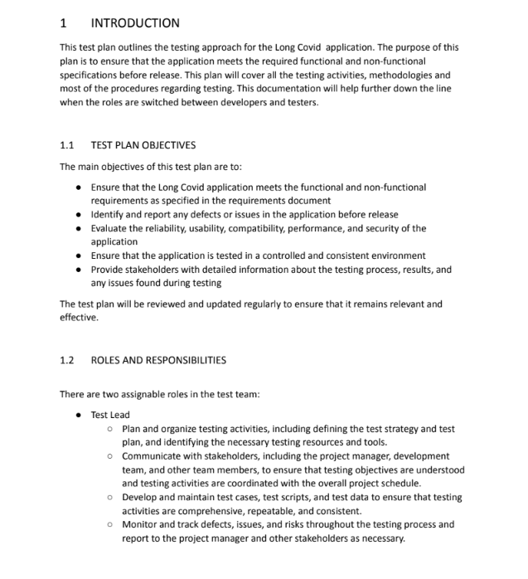
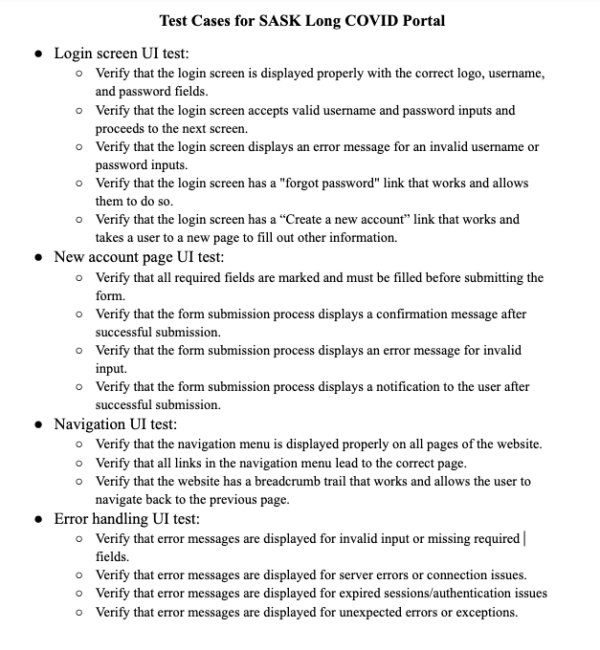
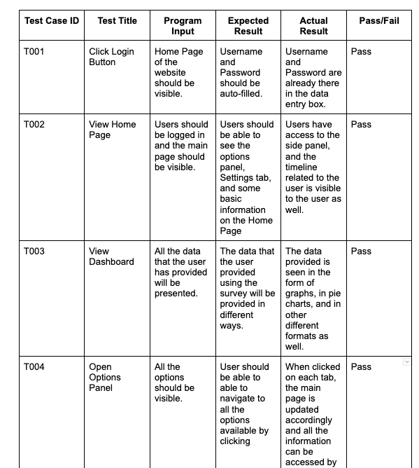
Test Plan
Test Cases
Test Matrix
Outlines test objectives, scope, strategies, environment, schedule, roles & responsibilities, and risks
Assesses functionality, usability, and security of each feature of the system to verify they fulfill requirements
Provides overview of tests & tracks actual results of those tests against the expected results
Notes:
Chi, Sashti, and Vaidehi were our testers for this deliverable. They worked on the test plan, generating test cases from the requirement document, and from those test cases, formed the test matrix.
The test plan serves as a blueprint for the entire testing process and provides a structured approach to testing the software. These include:
Objectives: cover overall goals and objectives of the testing process.
Scope: The areas of the software that will be tested, including any features or functionalities that will be excluded from testing.
Test strategy: The overall approach to testing, including the types of tests to be conducted (e.g., functional, performance, security) and the testing techniques that will be used.
Test environment: The hardware, software, and network infrastructure needed to carry out the tests.
Test schedule: The timeline for testing, including milestones and deadlines.
Risks and contingencies: Any risks or issues that may impact the testing process, along with a plan for how to address them.
Test deliverables: The specific documents and artifacts that will be produced as part of the testing process, such as test cases, test scripts, and test reports.
Roles and responsibilities: The roles and responsibilities of the various stakeholders involved in the testing process, including testers, developers, and project managers.
Then, we referred to the requirement document (which outlines the features to be implemented and their functionalities) to generate test cases. We formed user stories to describe the feature and wrote acceptance criteria for each story. These will be used later to for validation.
Lastly, we summarized the test cases in a test matrix. The test matrix provides a comprehensive overview of each test, inputs, steps taken, and compares the expected result against the actual results.

Slide 11
Reviews and Inspections
Retrospective Inspection and Reviews
The team discussed what we could have done better in the tutorial times.
Main issues that we improved upon:
Understanding technologies better since the steep learning curve slowed down our progress
One of our main developers dropped the class which taught us not to be dependent on one individual
Over estimation of goals due to incomplete understanding of the Template used for frontend

Slide 12
Reviews and Inspection
Peer reviews and Code Reviews
We conducted several code review session along with pair programming with the development team.
We were working to get rid of the template and implement user login/registering.
Setting up the database and testing it with the frontend and backend was done in this code reviewing sessions.
For peer reviews, our team met over Discord and split up into smaller teams to go over peer’s artifacts and comment on it.
We pick different members of our team every deliverable to give everyone a chance for peer reviewing.
The peer review contains a summary of the artifact, comments on what the person did good and what improvements they can make.

Slide 13
Plan for next deliverable
Creating prototypes for table and timeline for the dashboard page
Create an admin side interface
Admin able to add/remove users
Possible graphs for different symptoms
Putting data from csv files into our DB
Filter data for the ‘My Journey’ timeline
Implement unit testing and integration testing(actual code)
Styling the frontend by abiding to the design principles
Creating a risk matrix to better assess and deal with risks

Slide 14
Questions?

